Slide 1

Team leader: Roberto Di Biase,
Christopher Daldalian, Anita Mirshahi, Dmitrii Kudrik,
& Valini Rangasamy

Slide 2
Standards used in our project
Using GitHub to save our project so that the team can work together
Using GearHost to save our database on the cloud so that the team can have access to the same data
Using Maven MVC architecture

Slide 3
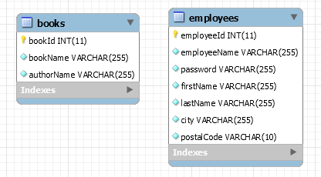
Standards used in our project
Using JDBC API
Using Code Conventions: refactoring, indent style, camel-casing, comments
Using MySQL Database

Slide 4
Problems and Challenges
Resolving GitHub Conflicts
Combining different approaches in one project
Challenges with Eclipse and resolving bugs, errors, like server connection

Slide 5
Lessons learned
How to implement MVC architecture
How to implement login/logout
How to use Sessions
How to implement Search
How to use include for consistent layout

